Slide 1




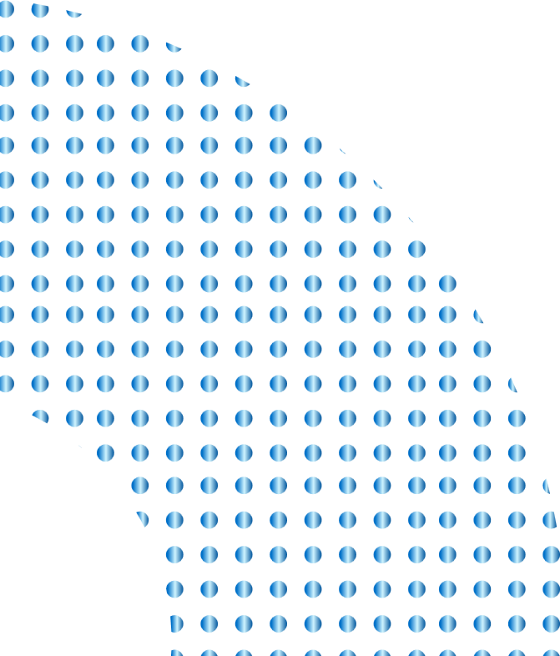

1. SQL Server, to store and process data
Processing Agenda Style
We successfully extracted and analyzed data, then transformed and loaded it through multiple stages, applying various techniques such as data repair and enhancement at different points. This process was carried out using,
SSIS, to ETL process
SSAS, to Analyze data
Power BI, to visualize data
SSIS
SSAS

Slide 2
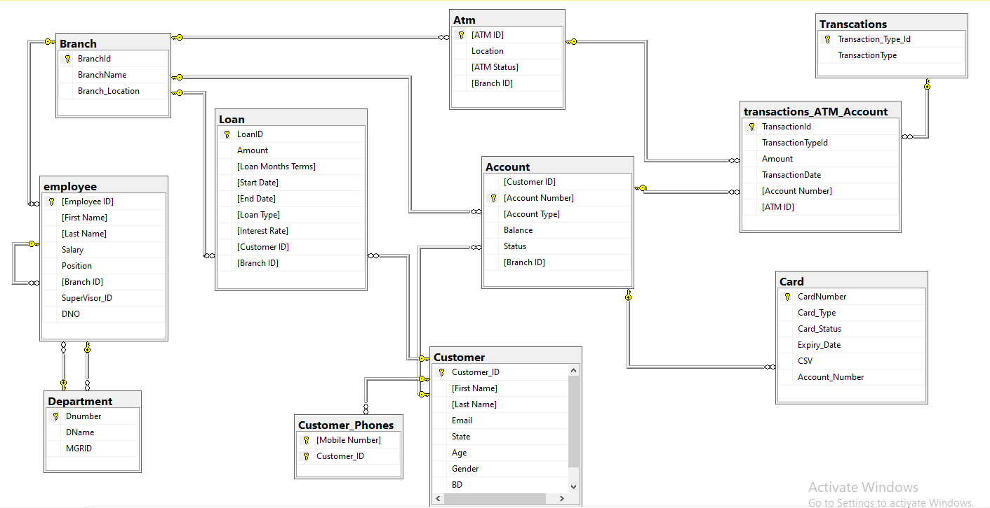
Database Diagram

Slide 3
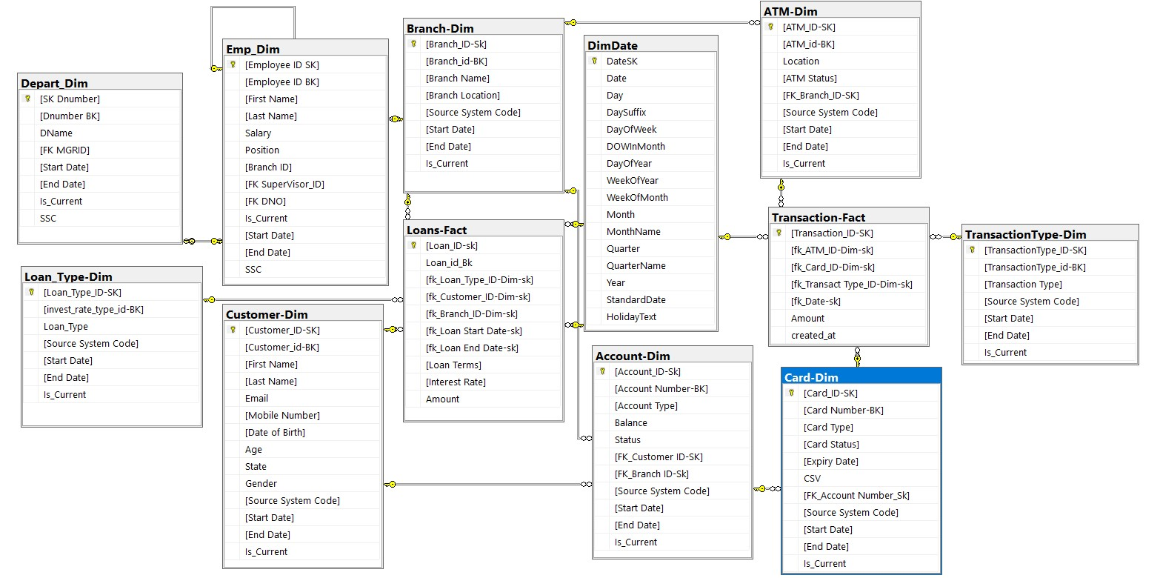
DWH Diagram

Slide 4
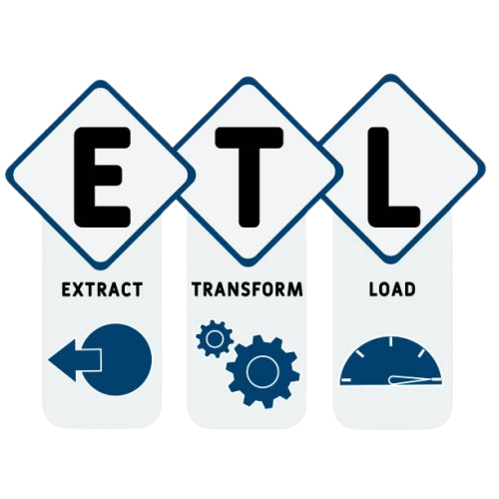

ETL Process Overview
To facilitate the analysis of Loan and Transaction data, an ETL (Extract, Transform, Load) process was implemented. This process transforms the data from Data Base into a structured SQL Server Data Warehouse (DWH). The following tables were created in the DWH to organize the data effectively:
Department staff-Dim
Transaction Type-Dim
Branch-Dim
Loans-Fact
Transaction-Fact
Card-Dim
Date-Dim
Account-Dim
Loan Type-Dim
ATM-Dim
Customer-Dim

Slide 5
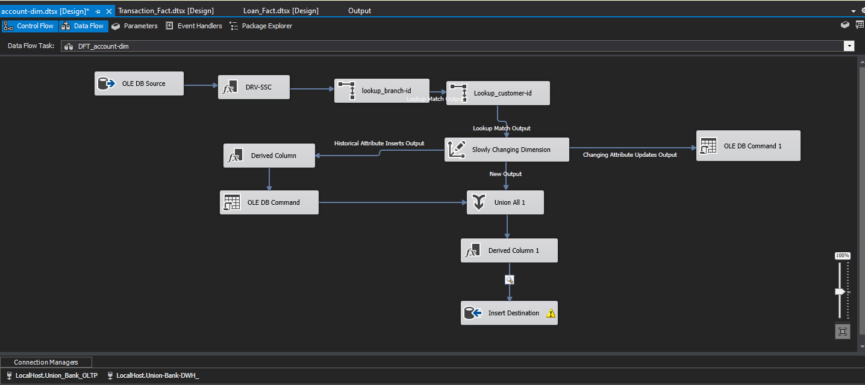
ETL Process Dim

Slide 6
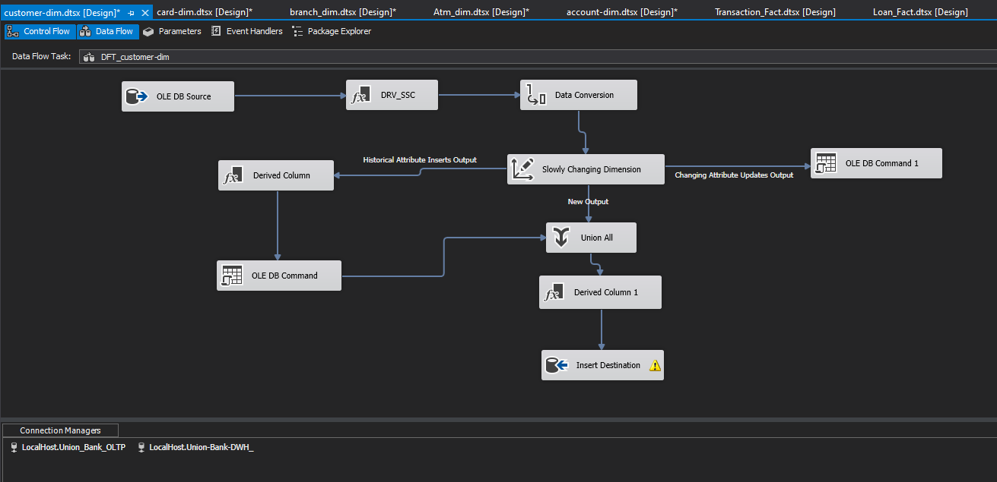
ETL Process Dim

Slide 7
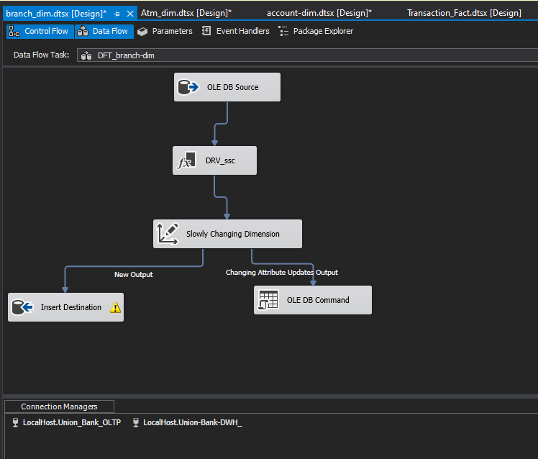
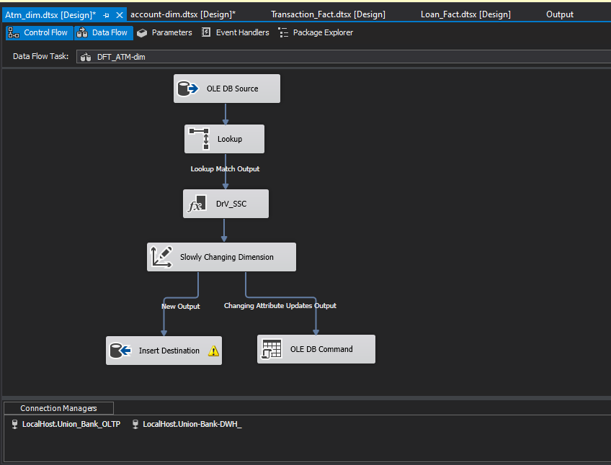
ETL Process Dim

Slide 8
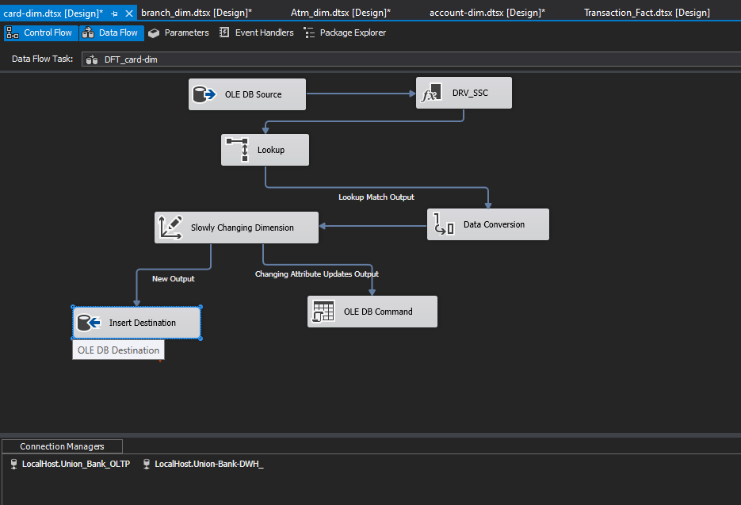
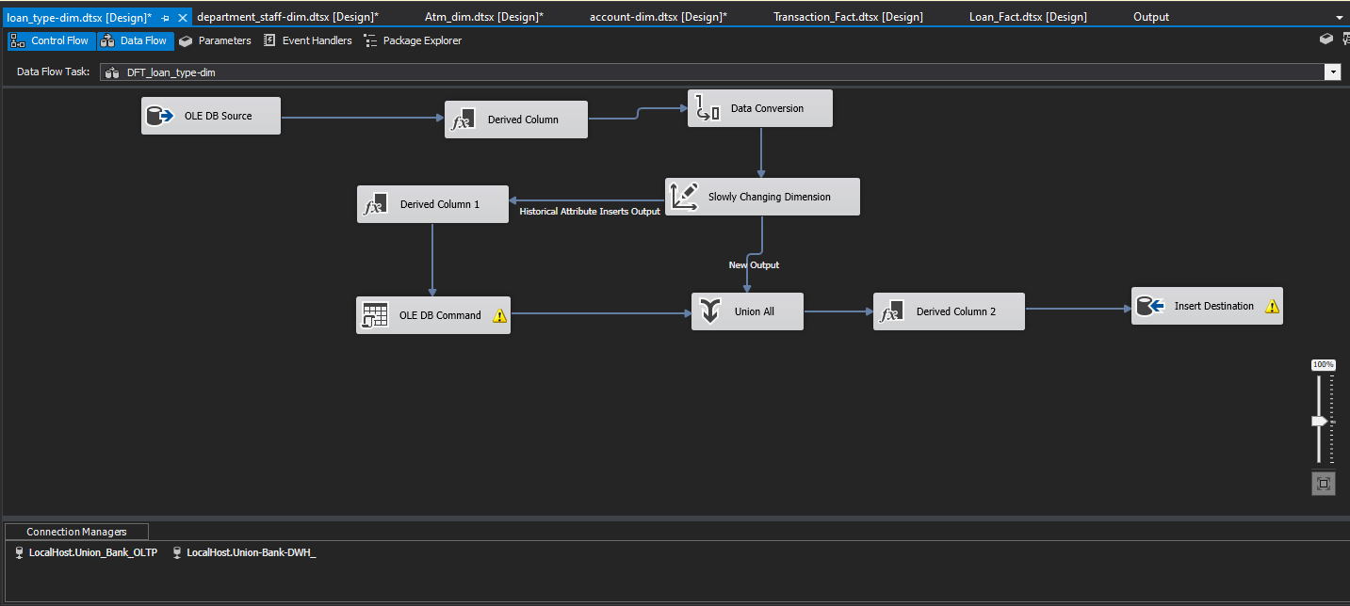
ETL Process Dim

Slide 9
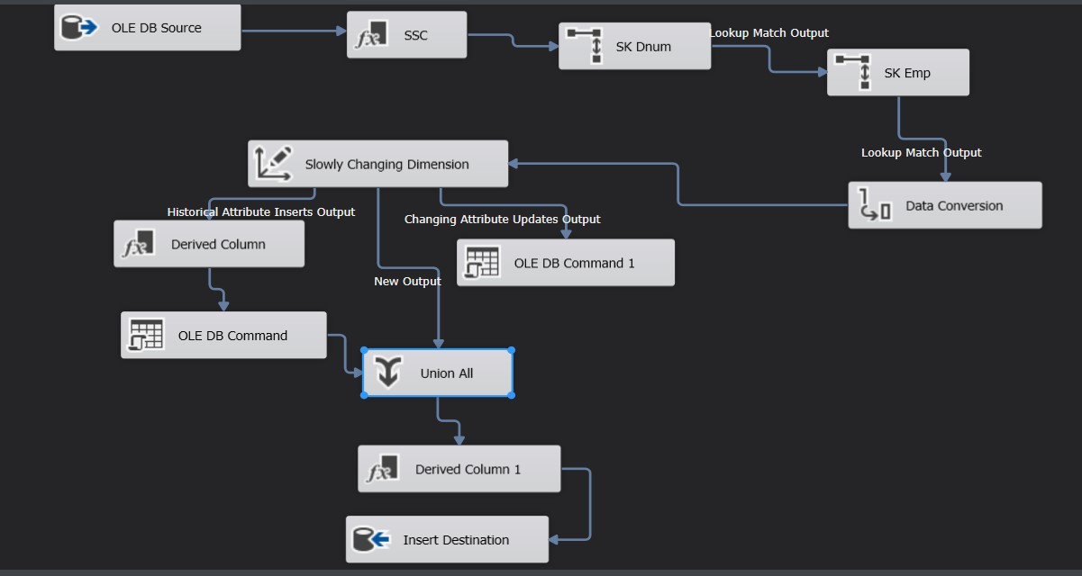
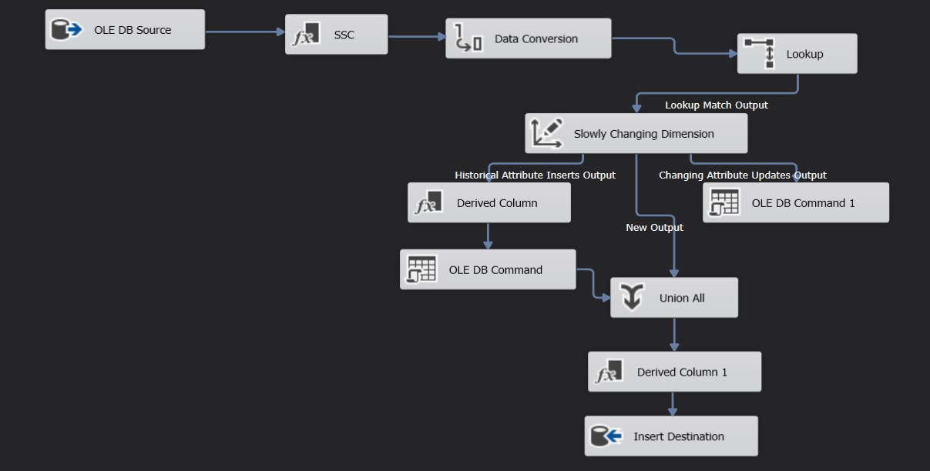
ETL Process Dim
Employee-dim
Department-dim

Slide 10
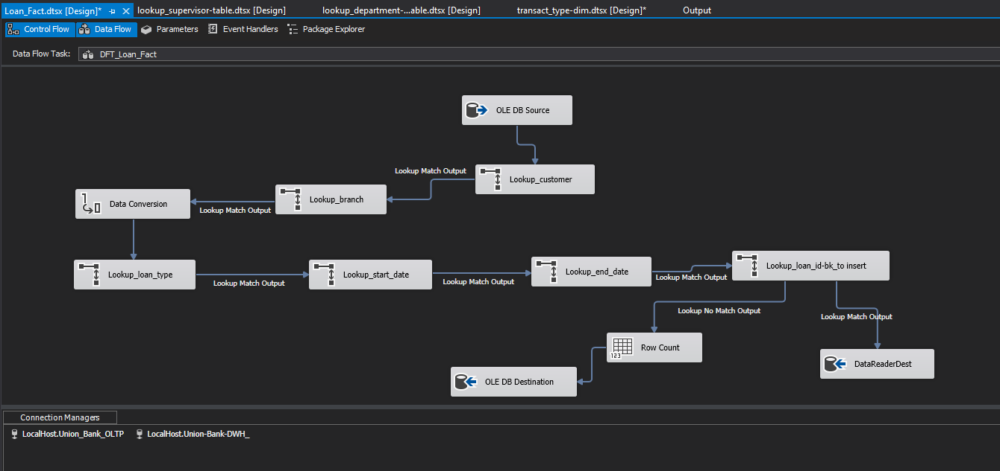
ETL Process Fact

Slide 11
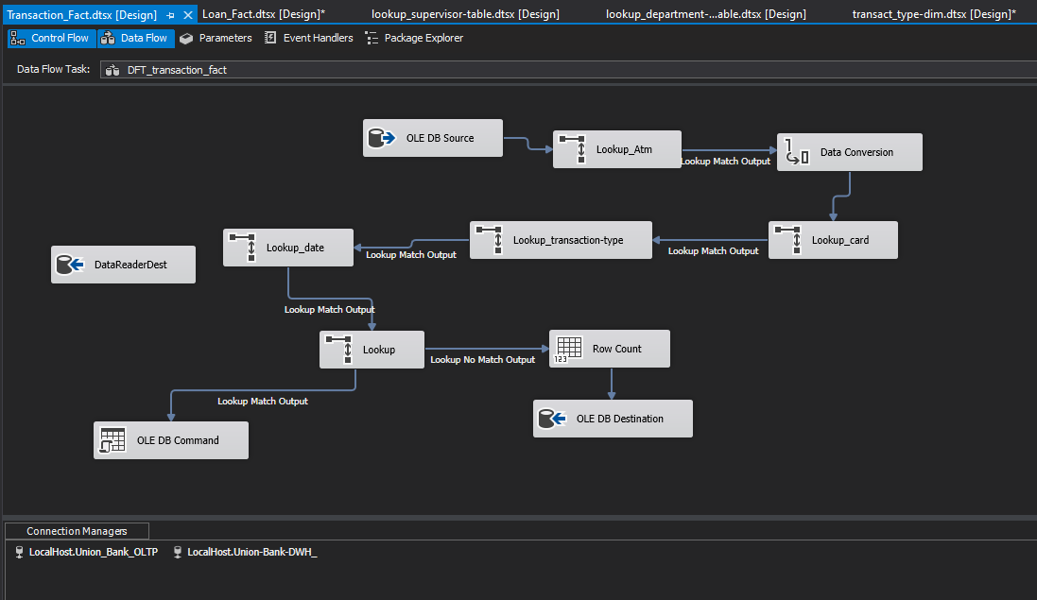
ETL Process Fact

Slide 12

ANALYZING DATA
inspects, cleans, transforms, and models data to extract insights and support decision-making

Slide 13


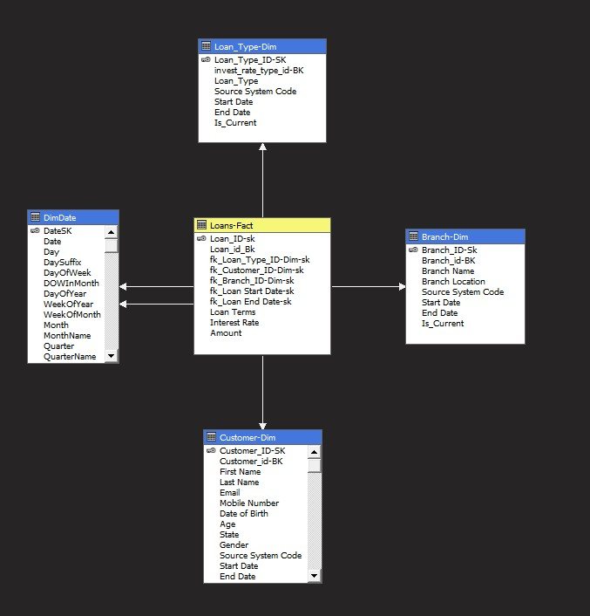

Slide 14

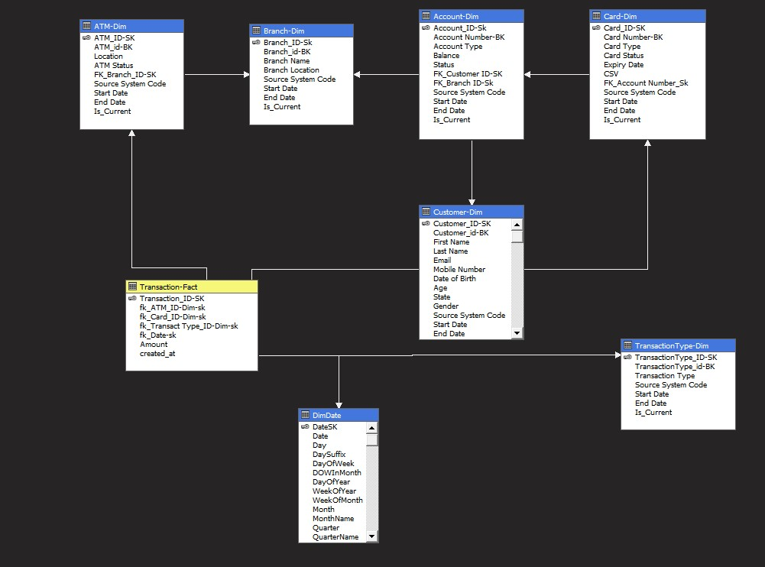

Slide 15
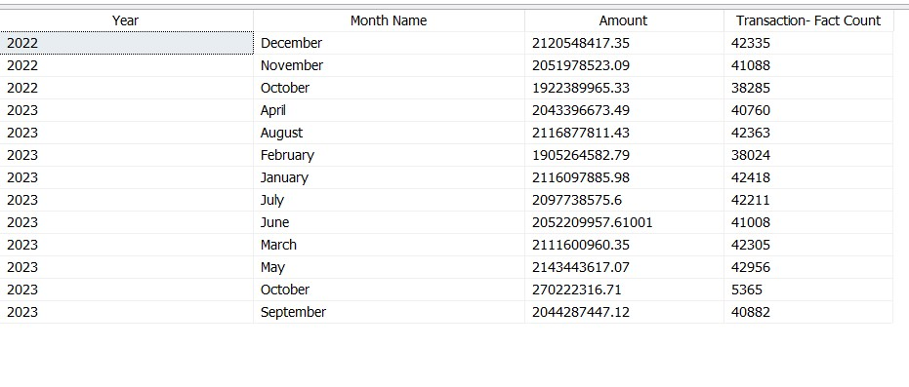
Transaction
Count & Amount Per Year
SSAS (Cube)

Slide 16
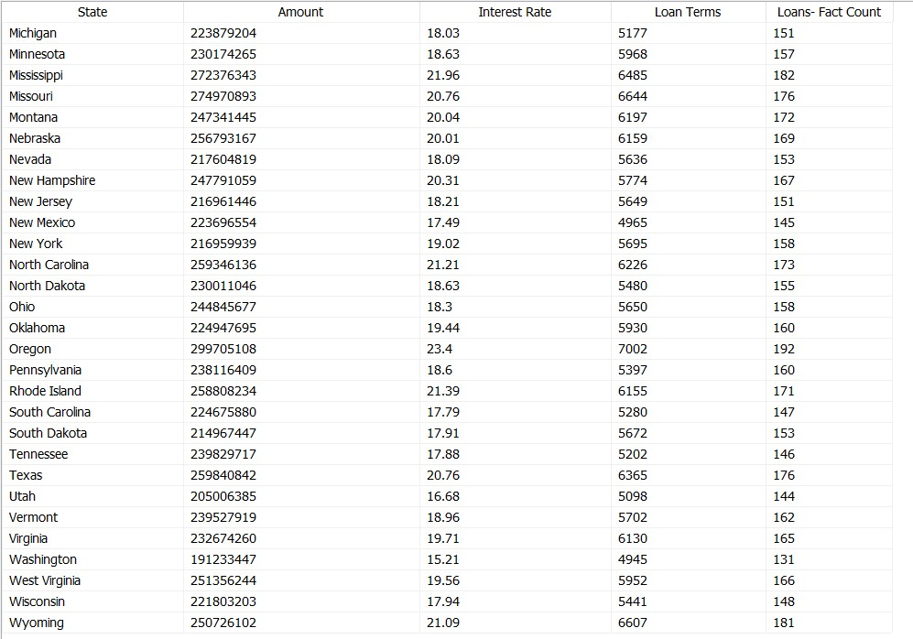
Loan Per State
SSAS - Cube

Slide 17

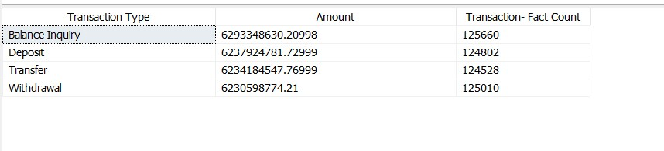
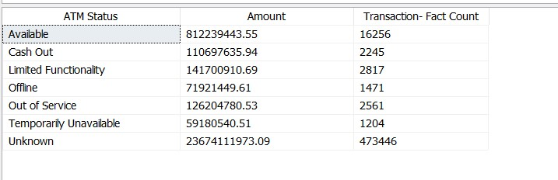
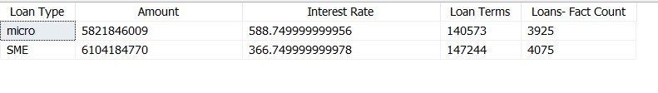
Count & Amount Transaction Type
Count & Amount
Atm Status
Count & Amount Loan Type
SSAS (Cube)

Slide 18


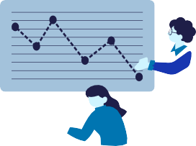










Our Project got through
Select Data Set
Union Bank from
Sources
Upload Database& define gauges
Extract Attributes tables specific and Transform dataset
From database with SSIS
To DWH
Create DWH
Design Datawarehouse
with Galaxy Schema
& measures
Transform database to DWH with SSIS
Data Analysis
Analysis data with
SSAS create cubes and generate Reports
Data Cleaning & Transformation
Cleaning data in power query Load transformation
Visualization
analyze data in
multiple ways:- Using Power BI, and
Excel

Slide 19
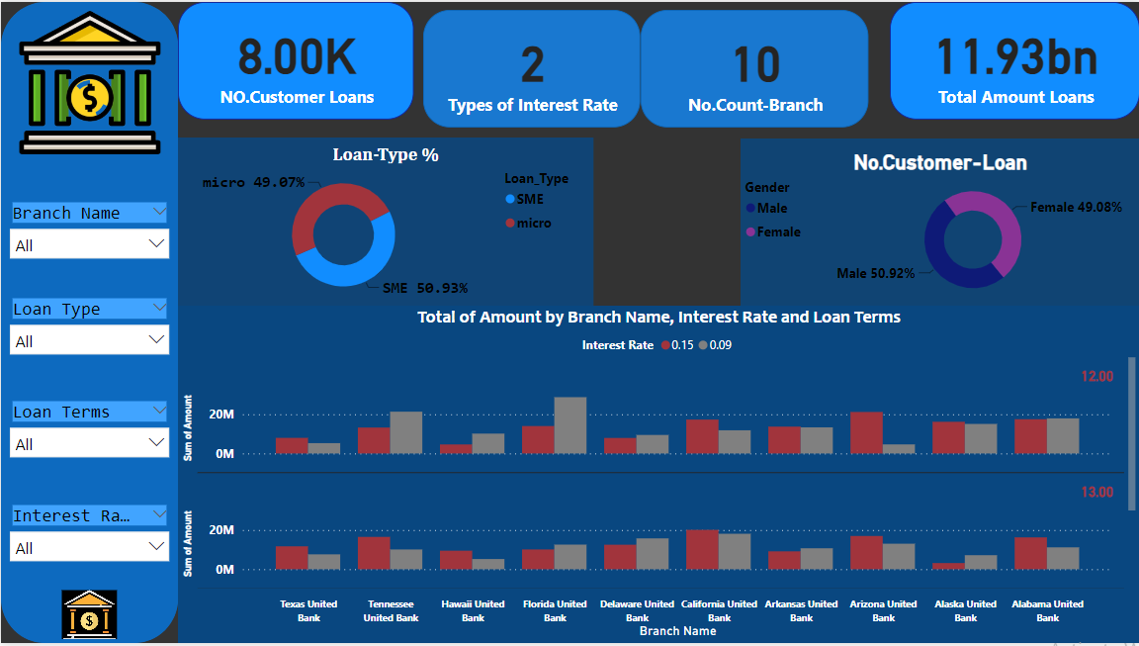
Overview

Slide 20
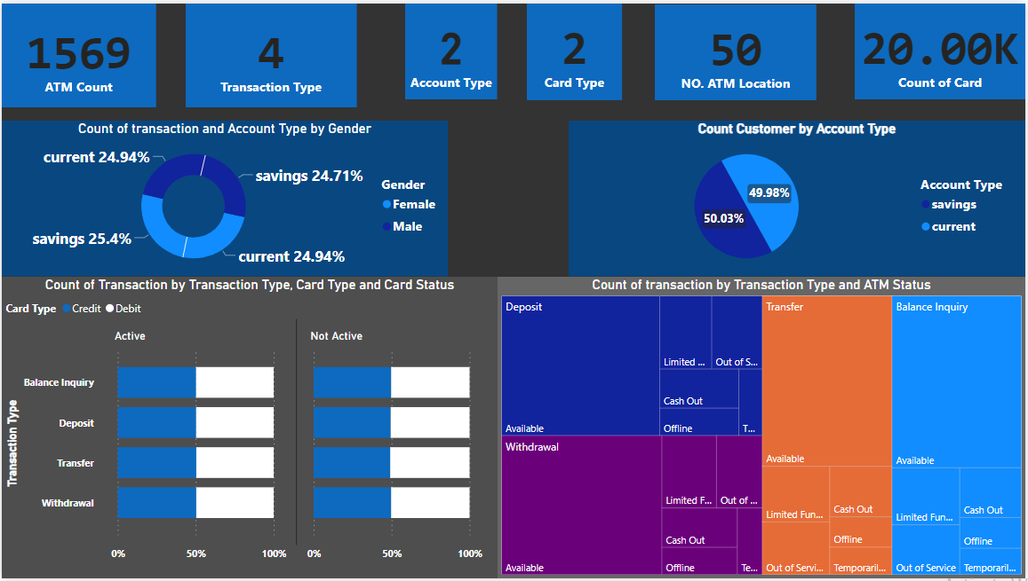
Bank Analysis

Slide 21





